Slide 1
Mess Automation
-Kevin jose
-Vineet anand
-Avi singh
-Prawaal Pandey

Slide 2
Project Overview
A TFT Display with Touchscreen shows the items and takes input, and a thermal printer prints invoice and/or coupons. The billing details are stored onto an SD card(For now) and the payment is secured through biometric identification i.e. a fingerprint scanner.

Slide 3
Implementation
Designing a working prototype of automated mess Coupon and billing system.
Making the system quick and reliable by using Biometric authentication(fingerprint).
Connecting the whole system with a server and designing a website for the purpose.

Slide 4
Current Status
Individual Components Working fine.
All codes upto date.
Facing some difficulties in hardware integration of individual components.
Working mainly on networking, till now able to use arduino as a server on local network.

Slide 5
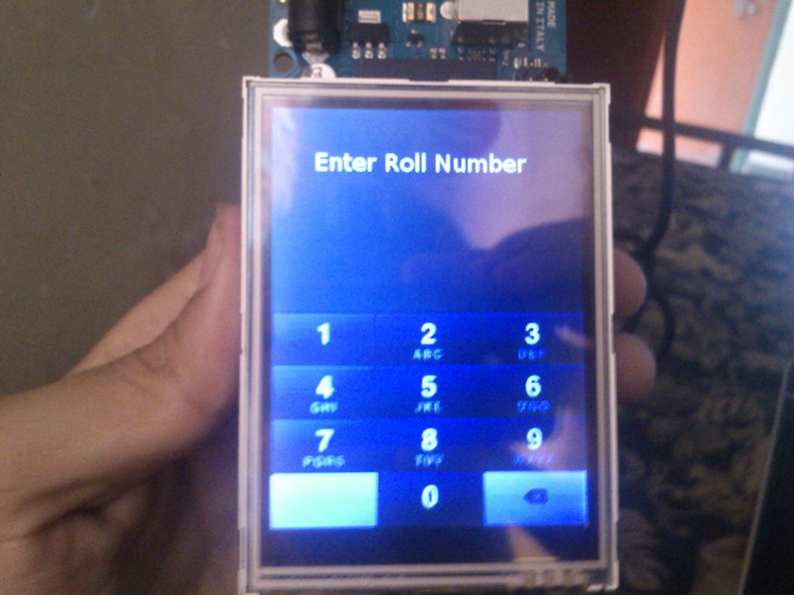
Our new User interface waiting for user to input his/her Roll no.
The touchscreen takes users’s roll no, and arduino uses this to search the coresponding fingerprint model array from the database.
The user is then asked to keep his finger on the scanner and the scanner matches the current finger array and the one stored in database and the authentication is complete.

Slide 6
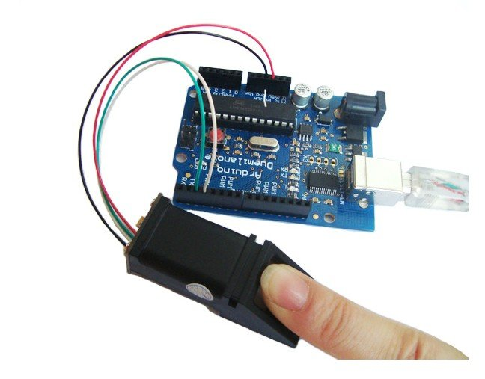
User validating his finger.
Once the authentication is done, user can select his orders from the menu and finalise the order.

Slide 7

Finger print scanner working.

Slide 8
Thermal printer printing the final bill

Slide 9
Workings yet to be Done
Integrating the whole hard ware and software.It will not take too much time after we receive the new tft display.
Establishing our own server and connecting arduino as a client to upload and download all the data from the server database.If not,using arduino as a server and acess and alter it from intranet via a HTML page.
Creating a webpage for admin to change the menu,price etc.
Other utilities like checking the monthly bill of each student and mailing it to them can be added in future.

Slide 10
Expected completion date of basic project: 19/6/13

